Slide 1

data.table
Zac Fenlon

Slide 2


What is data.table?
Like a data.frame
[ ]
Faster
Added functionality
Everything is done inside the [ ]
DT <- as.data.table(DF)
DT <- data.table(firstCol = 1:10,
secondCol = LETTERS[1:5])
DT[i, j, by]
Notes:
Can convert dataframe to datatable quote marks not required for column names – for creating them and for referencing them later – can use them as variables additional terms in the call, most notably “by” – which we’ll be using later

Slide 3

Why / when to use
Fast data processing
Ease of use
FAST DATA PROCESSING
EASE OF USE
Notes:
EOU- I find it to be a misunderstanding that data.table is harder to learn to use than other packages for data manipulation
– normally only requires one or two lines of code to achieve what youre aiming for

Slide 4
Pivoting
SQL
data.table
declare @values NVARCHAR(MAX), @query AS NVARCHAR(MAX);
SET @ values = STUFF((SELECT distinct ‘,’ + QUOTENAME(Category)
FROM SampleData
FOR XML PATH(‘’), TYPE
).value(‘.’, ‘NVARCHAR(MAX)’)
,1,1,’’)
SET @query = ‘ SELECT County, ‘+@values+’ FROM
(
SELECT top 100000 [Country]
,[Category]
,[Value]
FROM [SampleData]
) sampleQuery
pivot
(
sum([Value])
for [Category] in (‘+@values+’)
) as tbl’
execute(@query)
dt2 <- dcast(dt, Country ~ Category, drop=FALSE, value.var = “value”, fun=sum)
Notes:
First time looking into datatable for me was when trying to speed up pivots on large datasets. Not only do they take a long time to execute, but the resulting code can quickly become expansive.

Slide 5
Pivoting
rows | SQL | reshape2 | data.table
1.E+03 | 2 | 0.2233 | 0.0048
1.E+04 | 2 | 0.2855 | 0.0085
1.E+05 | 3 | 0.3020 | 0.0228
1.E+06 | 6 | 2.0394 | 0.3974
Notes:
1e6 rows, 249 variable a, 500 variable b first run in SQL took over a minute – times shown are using cached data

Slide 6
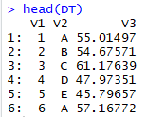

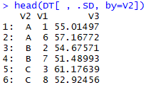
Grouping
DT[i, j, by]
takes DT, subsets the rows using ‘i’, then calculates ‘j’ grouped by ‘by’”
.SD
is all the columns that aren’t in the group
DT <- data.table(V1 = 1:10,
V2 = LETTERS[1:5],
V3 = rnorm(10, mean=50, sd=10))
DT[, .SD, by=V2]

Slide 7
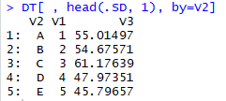
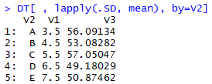
Grouping
First row of each group
Mean value in each group
DT[ , head(.SD, 1), by=V2]
DT[ , lapply(.SD, mean), by=V2]
Notes:
DT[ , head(.SD, 1), by=V2]
DT[ , lapply(.SD, mean), by=V2]

Slide 8
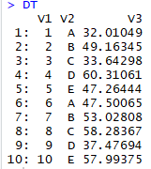
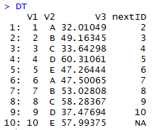
Assignment by Reference :=
DT <- data.table(V1 = 1:10,
V2 = LETTERS[1:5],
V3 = rnorm(10, mean=50, sd=10))
DT[, nextID := DT[.I+1]$V1]
DT
Notes:
Assignment by Reference
Note that the Data table is changed in place, this can catch you out if you’re just wanting to try something out ( DT2 <- copy(DT))

Slide 9
Keys & Indexes
Speeds up row lookups
Relatively expensive to create
setkey(DT, V2)
DT[“A”]
Notes:
Example data set is n by 3
Scales are log

Slide 10
fread & fwrite
Speeds up reading + writing files
read.csv("data/businesses-in-london.csv")
data.table::fread("data/businesses-in-london.csv")
file size / KB | read.csv | write.csv | fread | fwrite
82788 | 25.96 | 8.52 | 0.25 | 0.08
597647 | 94.63 | 41.54 | 7.78 | 0.47
Notes:
These datasets are from the London datastore data.london.gov.uk
4003x11 to 1.1M x 62
715872x10
https://data.london.gov.uk/download/directory-of-london-businesses/d7514196-81ba-40da-aa12-affbd84b59d8/businesses-in-london.csv

Slide 11
Useful Links
https://data.london.gov.uk
https://www.r-bloggers.com/intro-to-the-data-table-package/
https://www.datacamp.com/community/tutorials/data-table-cheat-sheet
zac.fenlon@objectiveit.com

